Slide 1
INFO 330 Project 1

Slide 2
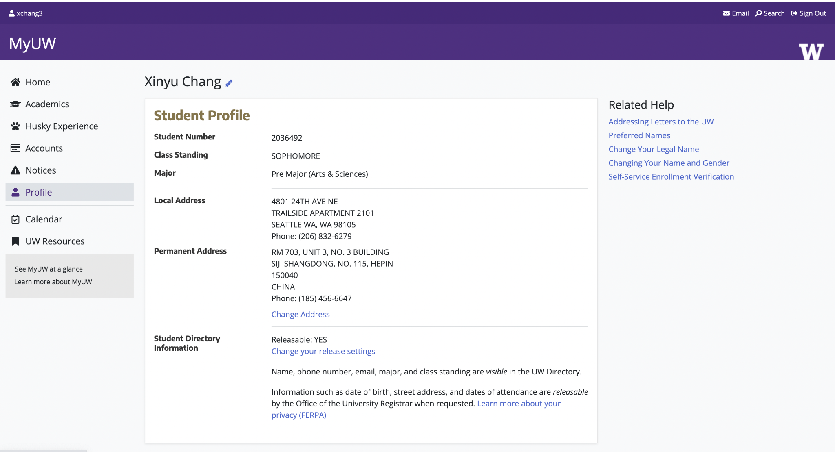
Student
Student Name
Student Number
Class standing
Major
Local Address
Permanent Address

Slide 3
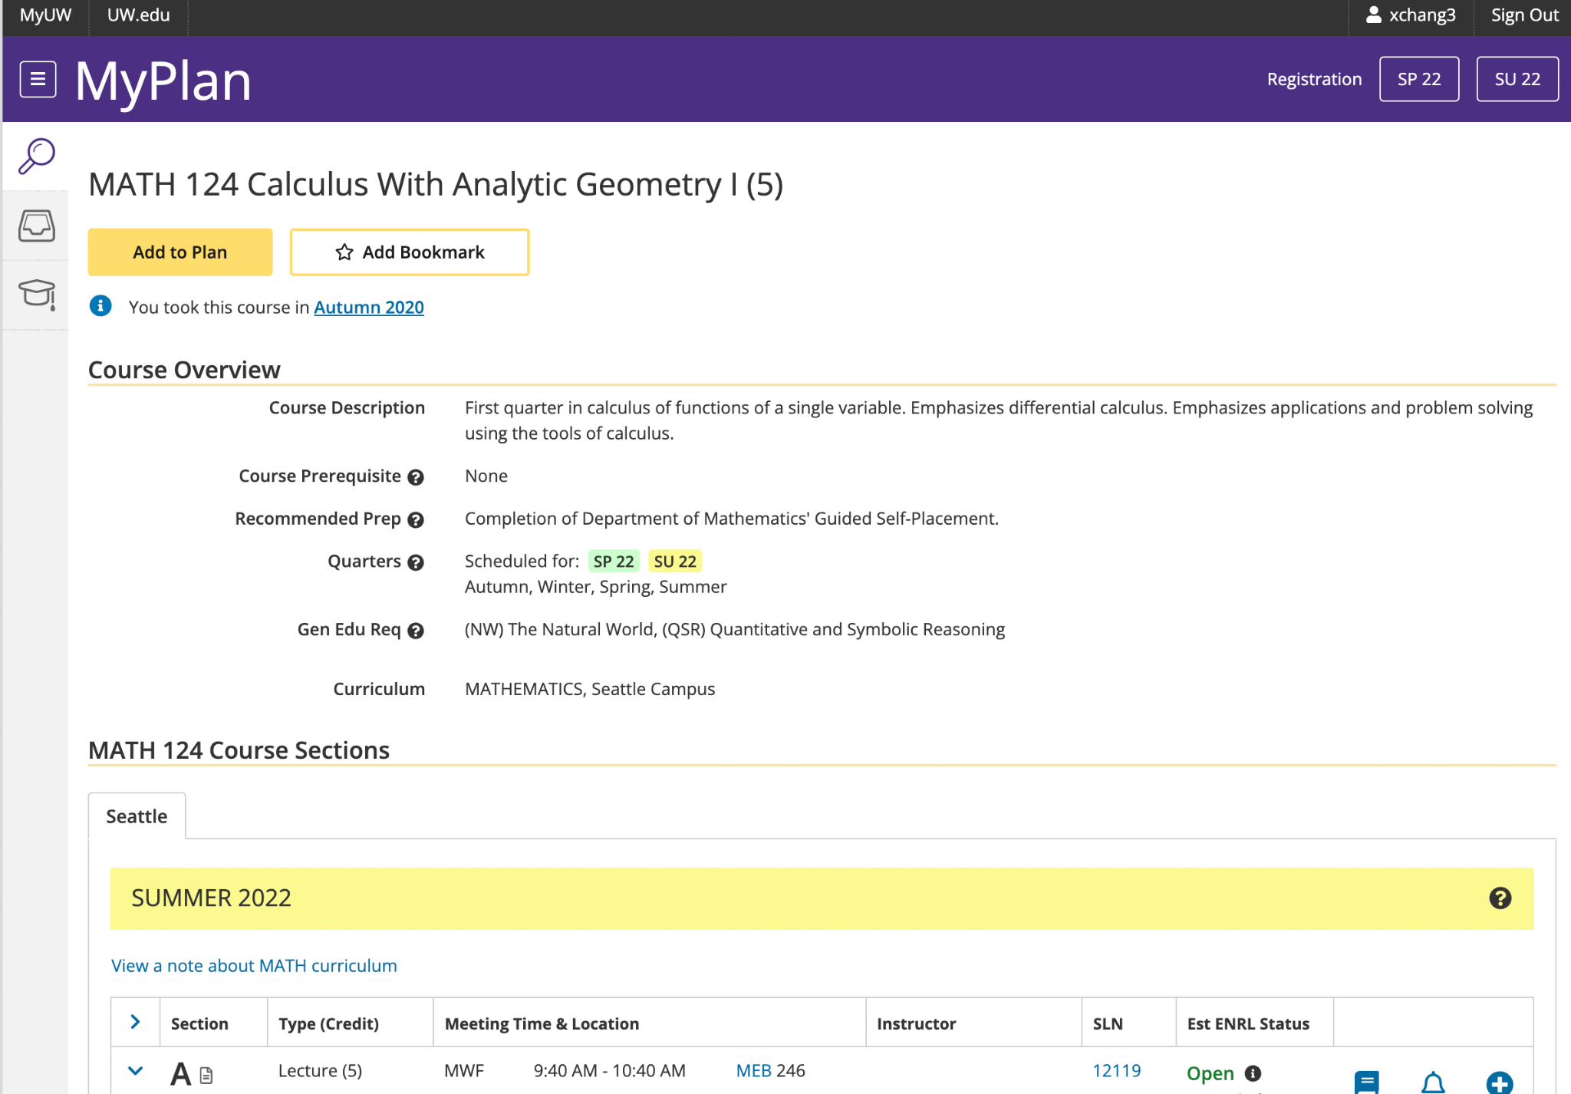
Course
Course Title
Course Description
Prerequisite
Recommend Pre
Quarters
Gen Edu Req
Curriculum

Slide 4
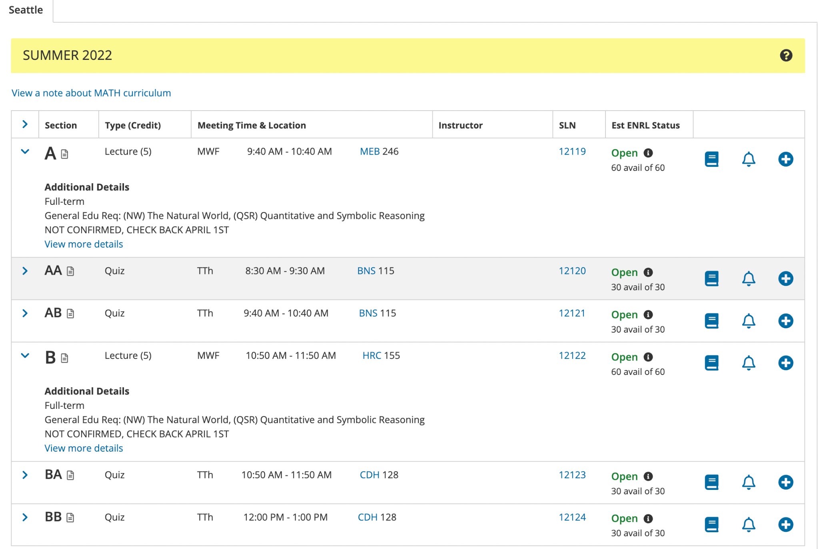
Section
Type(credits)
Instructor
SLN
Est ENRL Status
Additional details
Meeting Time
Building
Seats availability

Slide 5
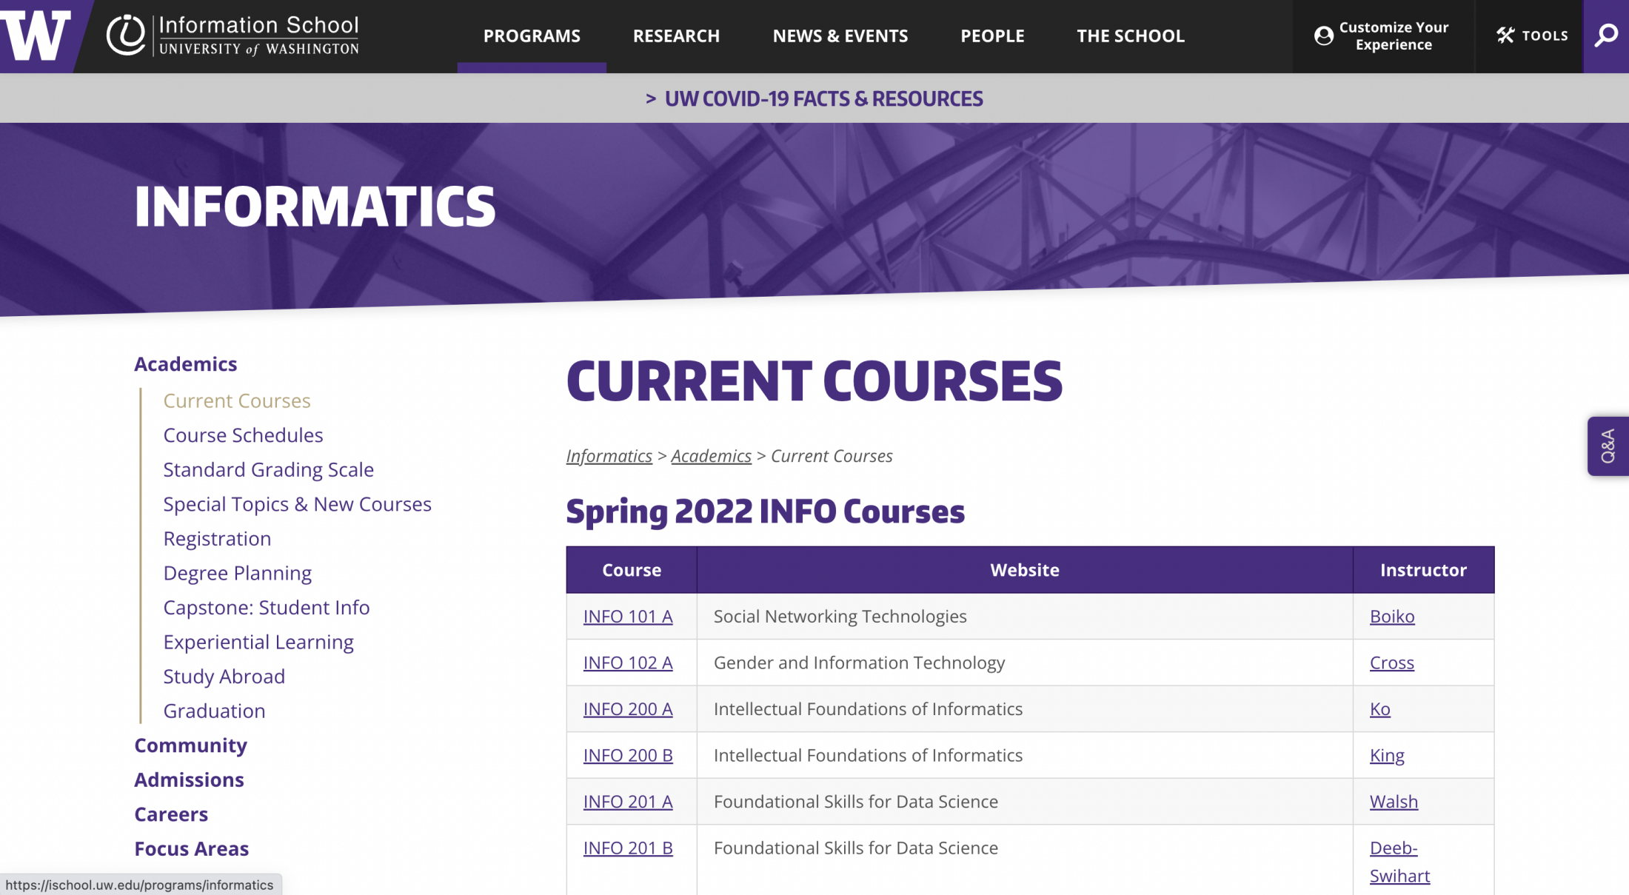
Department
Course
Website
Instructor

Slide 6
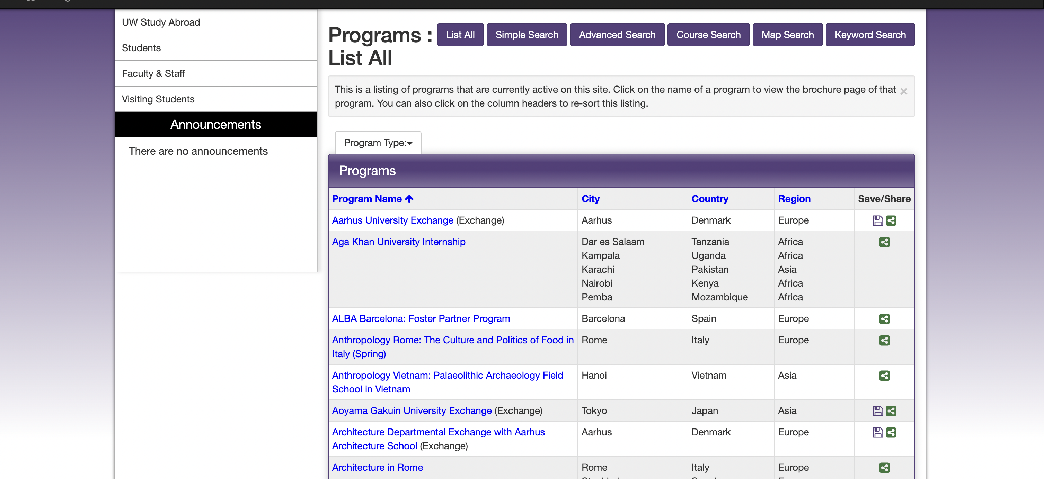
Study Abroad
City
Country
Region
Program Name

Slide 7
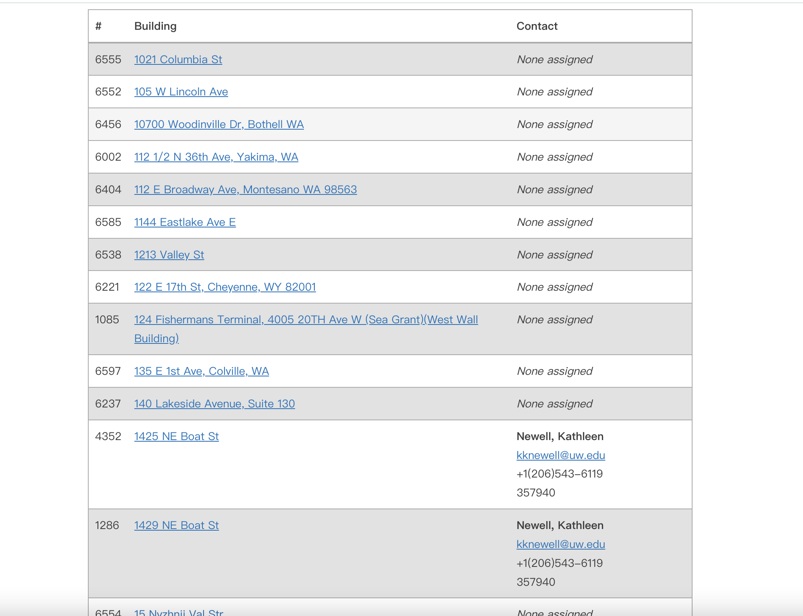
Building
Building Number
Building Address
Contact

Slide 8
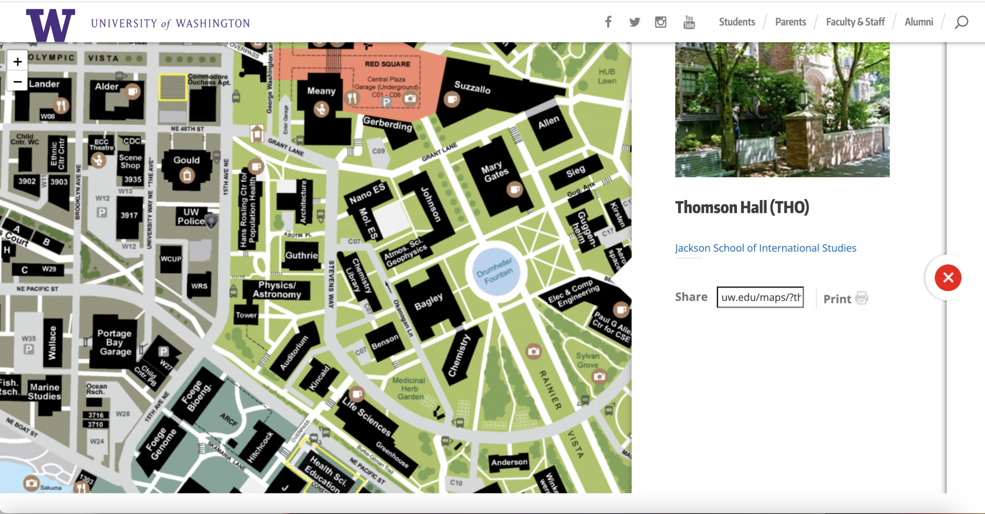
Photo
College Full Name
Department
College URL

Slide 9
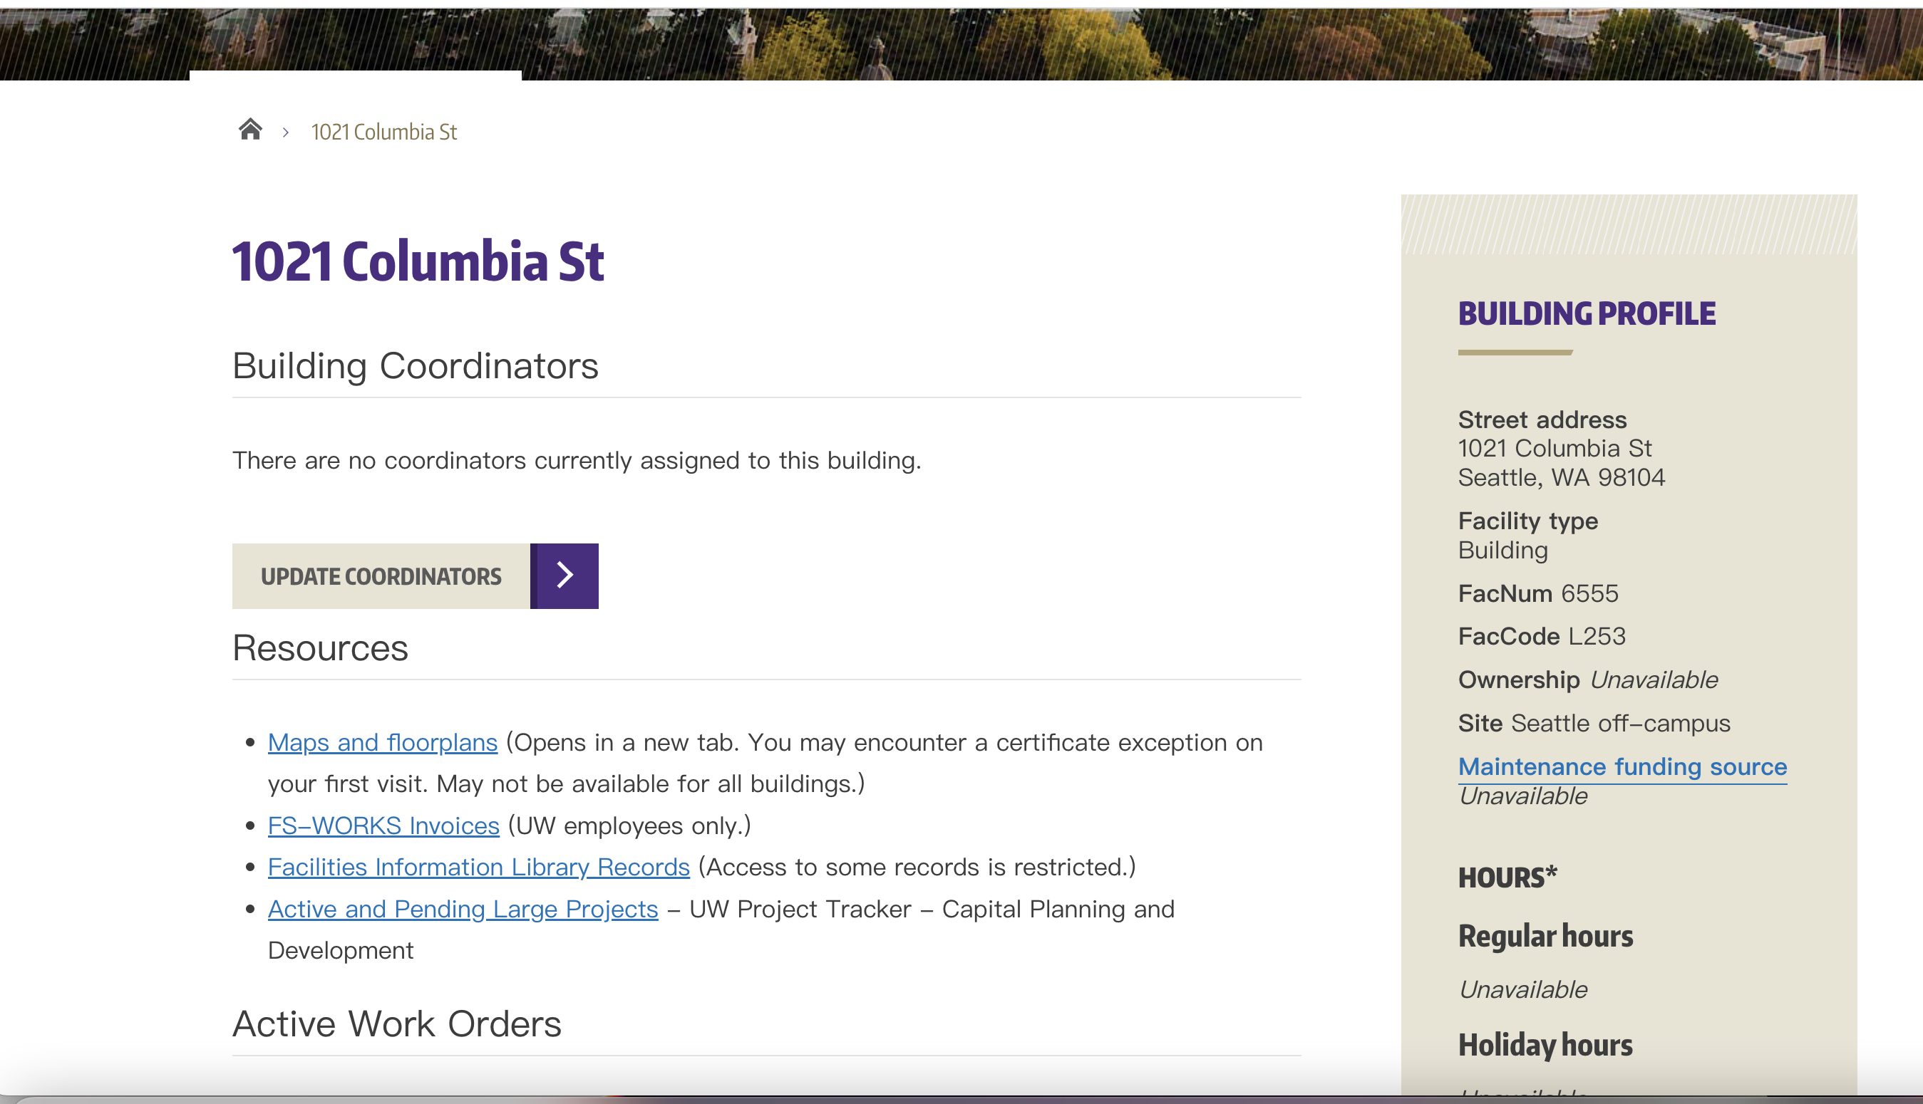
Building type
FacNum
FacCode
Site
Open hours

Slide 10

Instructor
Department Name
Instructor Name
Photo
Instructor Title
Email
Introduction website
Phone number
Fields of interest

Slide 11
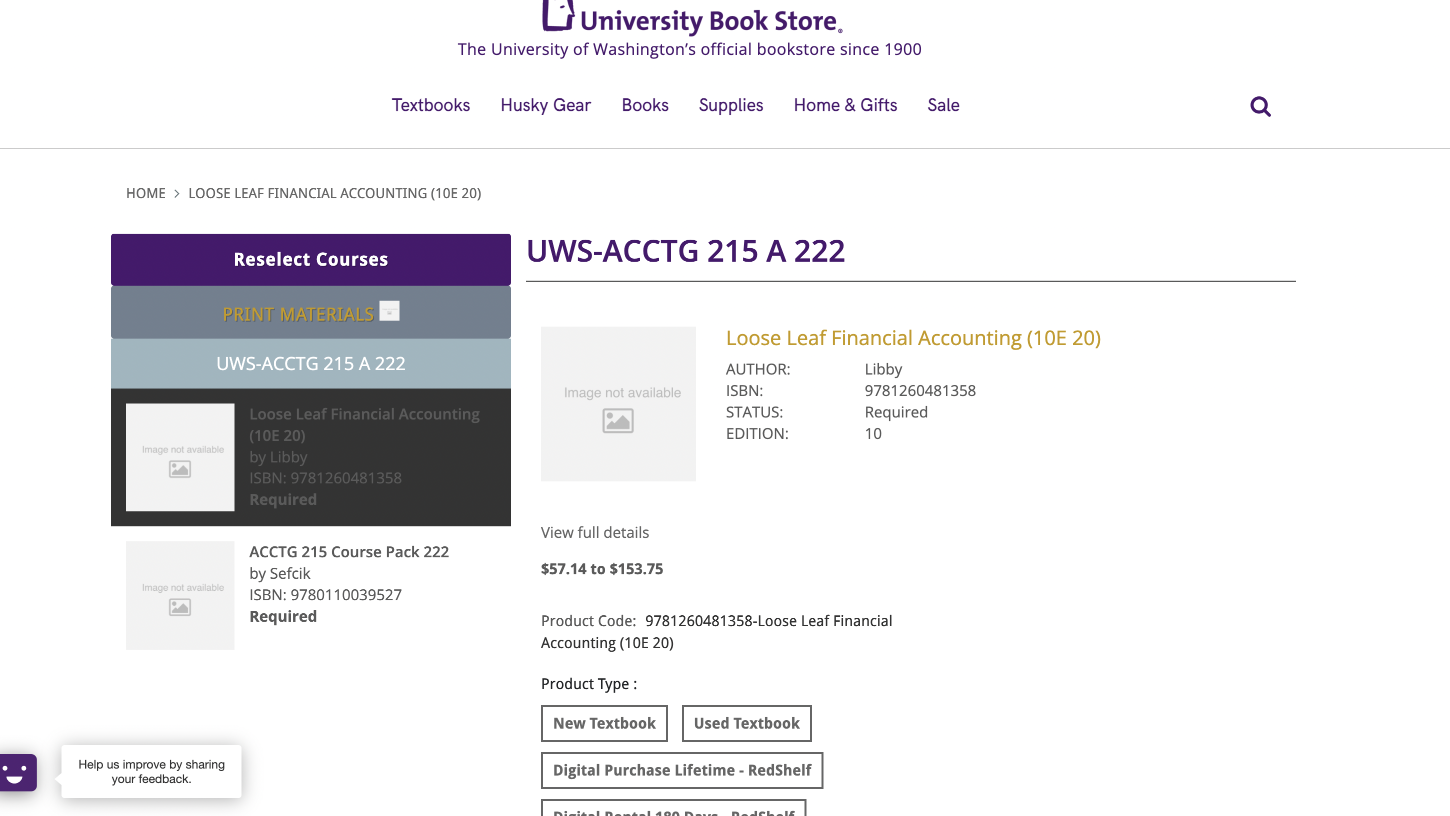
Textbook
Author
Book Title
International Standard Book Number
Edition
Price
Product type

Slide 12
Relationships
Student
Many to Many
Course
Department
One to Many
Course
Department
One to Many
Study abroad
Building
One to Many
Course
Instructor
Many to Many
Course
Course
Textbook
Many to Many
Student
Many to Many
Study abroad

